Slide 1
Chapter 8 – Time series
Artificial Intelligence

Slide 2
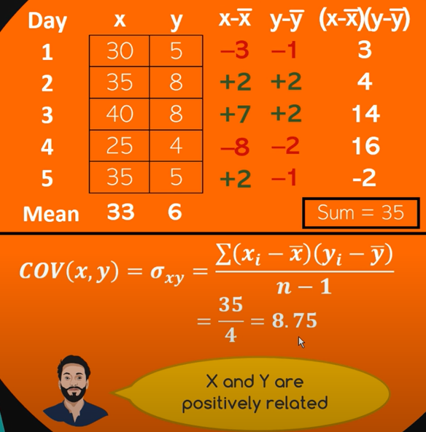
Non-time-series data
We have days and record temperature and ice cream sales per day
The dataset has one average for temperature and one for sales
These numbers wouldn’t change if we moved the days around
Swap day 2 and 4

Slide 3
Time series data
Definition: Time series data is a sequence of data points collected or recorded at specific time intervals.
The time component is critical: the data points are ordered chronologically.
Observations at different time points often exhibit dependencies. Future values can depend on past ones (depicting trends and seasonality).
Time intervals can be regular (hourly, daily, monthly) or irregular, depending on the domain (e.g., stock prices vs. event-driven data).
A time series can be univariate (one variable measured over time) or multivariate (multiple variables measured simultaneously).
Applications: Forecasting (sales, stock prices), anomaly detection (in industrial equipment), and pattern recognition (speech, ECG data).

Slide 4


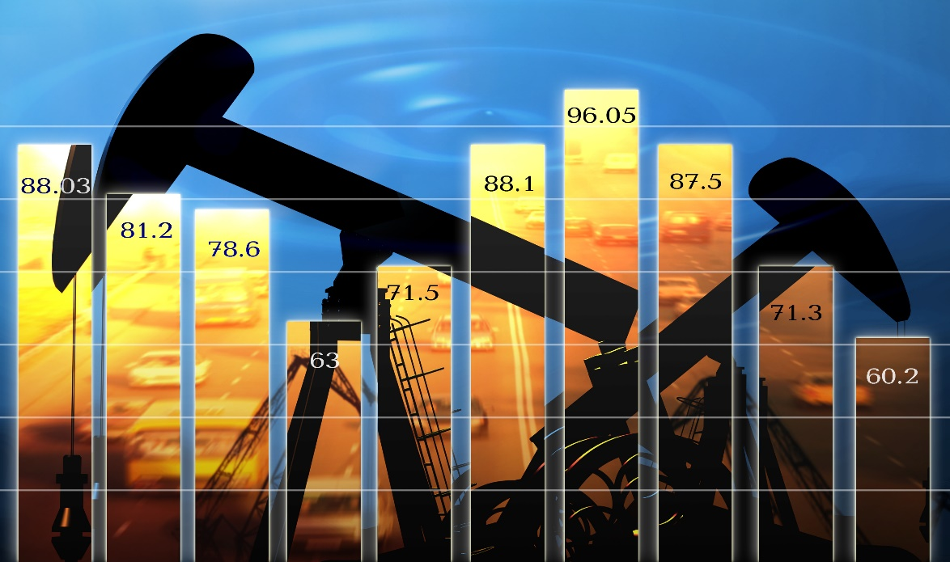

Forecasting use cases
Sales and demand forecasts
Inventory projections
Energy consumption
Weather forecasts

Slide 5
Trends in time series data
A trend is a long-term increase or decrease in the data over time, reflecting an underlying direction in the data.
There are the trends we also see in ‘normal’ data:
Upward, downward, linear or exponential, logarithmic (= reverse exponential)
In ‘normal’ data this required two variables, now only one
But there are also time-series specific types of trends:
Seasonal

Slide 6
TraiN/test-splits
In regular ML:
You can randomly shuffle data before splitting
Future labels don't depend on previous ones
In time series:
Order matters — today depends on yesterday
You must never use future data to predict the past
The most common solution: split at a certain point in time
Train on the past, test on the near past and do inference on the future
Retrain the model as new data becomes available

Slide 7
Filling NaN values
Forward Fill
Moving Average
Last known == missing value
Avg(previous) == missing value
Backward Fill
Interpolation
Next value == missing value
Linear
Spline
Polynomial
Danger! Lookahead risk!
Note: Zero is sometimes the perfect fill value

Slide 8
Outliers
outliers
Smoothing function
Why are you smoothing?
Data preparation
Visualization
How does smoothing affect your outcome?
Cleaner data to model
Model compatibility
Production improvements

Slide 9
Evaluation metric: RMSE
RMSE is the square of the errors.
Test | Actual result | Prediction | Deltas
1 | 2 | 4 | 2
2 | 4 | 8 | 4
3 | 8 | 12 | 4
4 | 16 | 28 | 12
 |  | RMSE | 6.708204
Error is the difference between the actual
target value and the forecasted value
Works best for a model where most errors are of similar size

Slide 10
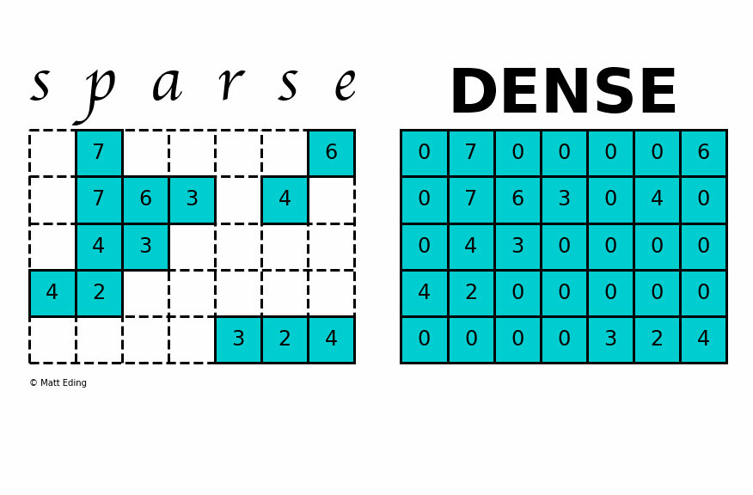
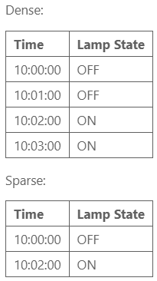
Sparse vs dense datasets
How frequently and consistently data points are recorded?
A dense dataset has a value for every time step in the series — even if nothing changed.
Regular intervals: Data is recorded consistently (every minute, every hour)
No missing timestamps.
A sparse dataset only includes entries when something happens
Irregular intervals
Gaps between events

Slide 11
Sparse vs dense datasets
Use Dense Datasets when:
You have high-frequency data without much sparsity.
You need simpler calculations and visualizations.
Memory is not a constraint.
Use Sparse Datasets when:
Your data has many zeros or missing values (e.g., binary indicators, intermittent signals).
You’re working with event-driven or irregularly changing data.
Memory efficiency is essential due to dataset size.
For applications where you need both memory efficiency and the continuity of dense datasets (like with rolling windows on sparse data), it’s often helpful to start with sparse data and convert it to dense format only for specific analyses.

Slide 12
Why It Matters
Dense data is easier to work with for things like rolling averages, resampling, and plotting
Sparse data is more compact and efficient when recording only changes or events (common in logs or event-driven systems)
To perform most time-series analysis, sparse datasets are typically converted to dense format
Using techniques like .resample() and .ffill() in pandas

Slide 13

Stationarity in time series
A stationary time series is one whose statistical properties (like mean, variance, autocorrelation) are constant over time.
No trend or seasonality
The series "looks the same" at any point in time
It's easier to model and predict because the behavior is consistent
The mean stays around 10
No trend (not increasing or decreasing over time)
Variance is stable

Slide 14


Stability (in control systems or broader dynamics)
Stability usually refers to whether a system returns to equilibrium after a disturbance.
In a stable system, values stay bounded or return to a steady state
This means a process that doesn’t explode or spiral out of control
Unstable:
Stable (but not stationary):

Slide 15
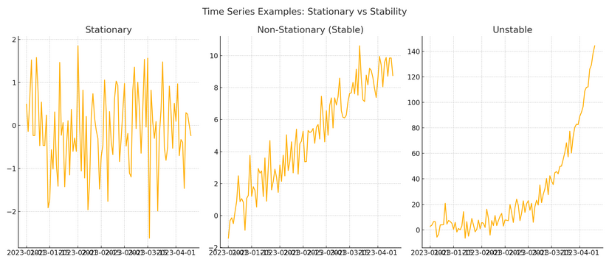
Stability and stationarity
Stationary: Data revolves around a center point
Stable (non stationary): Has an upward trend (mean and variance change over time)
Non-stable: data grows exponentially with increasing variance

Slide 16
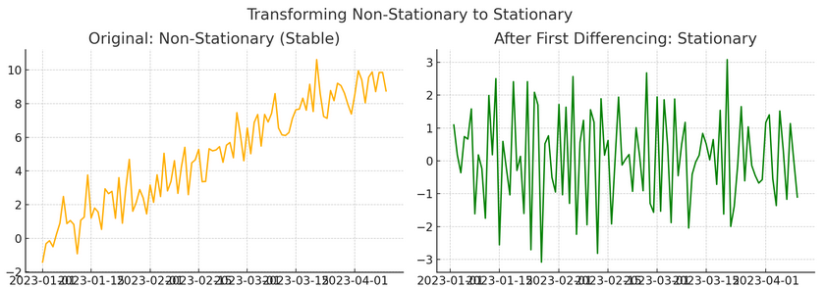
Stability and stationarity
If you apply a first-order differencing to a non-stationary dataset it becomes stationary
Constant mean with constant variance
This makes is suitable for many time series models like ARIMA

Slide 17


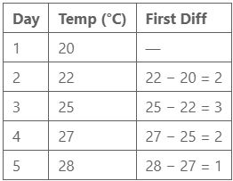

First order differencing
You deduct the previous datapoint from every datapoint
Example:
Why Use It?
Removes trend, making data more stable over time
Many models like ARIMA assume stationary input
Makes it easier to identify seasonality or cycles

Slide 18
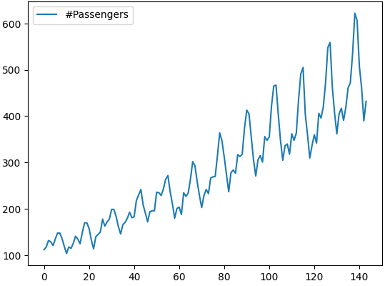

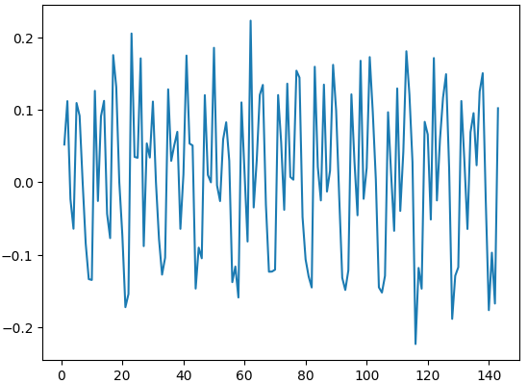
Stationarity
[You know you’re living on the edge when you need youtube videos with less than 1.000 likes.]
Link also in the notes below
The notebook used is also exercise 8.1
Notes:
https://www.youtube.com/watch?v=621MSxpYv60

Slide 19

Stationarity transformation
The original data was up to 600, the new data revolves around 0
How would a model trained on this new data yield a number I can use?
Inverse Transformations
After your model makes predictions on the transformed data, you undo the transformations to convert the results back to the original scale
When predicting multiple steps ahead, this has to be applied cumulatively
Libraries like statsmodels provide built-in tools for forecasting and inverting transformations
If you're chaining your own steps you need to manually reverse them

Slide 20
Stationarity transformation
Sounds exhausting! Can’t ARIMA do this for me?
Yes, ARIMA can do differencing internally
and it’s often better to let it handle it
An ARIMA(p, d, q) model:
p = autoregressive order (lags of the series)
d = order of differencing
q = order of the moving average
And what numbers do we need for p, d and q? Tuning!
Gridsearch: computationally expensive
Auto_arima: Uses statistical tests

Slide 21
Autocorrelation
Correlation is the measure in which two variables correlate
Warmer -> more ice cream sales
When looking at non-time-data, the order of the rows doesn’t matter
Auto-correlation is the measure in which a value correlates to a past version of itself
This value would help us to identify seasonality in the data
The thing with seasonality is it depends on the size of the season:
“Christmas” has a seasonality of 1 year
“Monday morning” has a seasonality of 1 week
If you don’t know your if dataset is seasonal, you also don’t know what size the season will have
That is why autocorrelation is calculated on different season sizes and you can decide which season (if any) fits your data

Slide 22
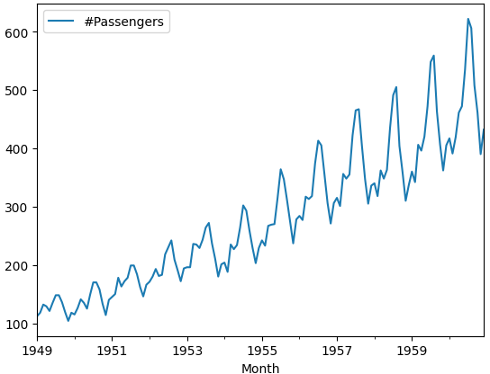
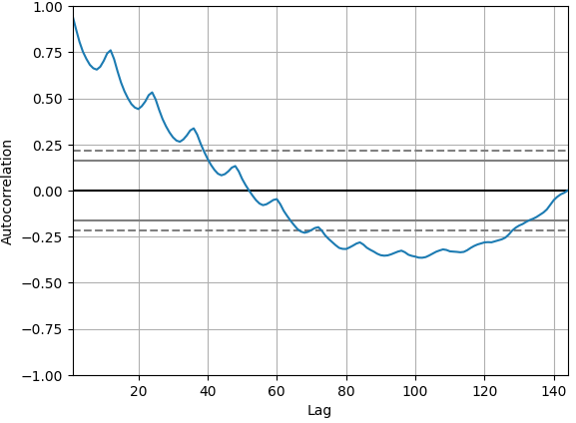
Autocorrelation
An autocorrelation plot on the airpassengers data
Data above: every year (12 months) looks roughly the same
A lot of passengers in the summer, less in winter
Autocorrelation plot:
Spikes at 12 (one year ago) and 24 (two years ago)
Notes:
https://www.youtube.com/watch?v=GcJ__g_cimA

Slide 23
The models
We’ve been talking about the arima a lot, but what is it? And what are the other models?
Arima
DeepAR+
Exponential Smoothing (ETS)
Non-Parametric Time Series
Prophet

Slide 24
Arima
Autoregressive integrated moving average.
This means it works using a moving (rolling) average over the data.
Good model when your data is non-stationary in terms of mean, but not in terms of variance.
This problem, the not being able to cope with variance, is somewhat dealt with by applying a seasonal differencing.
The autoregressive-part means that the predicted value is partly predicted by using a regression on earlier versions of itself.
Notes:
Information on Amazon: https://docs.aws.amazon.com/forecast/latest/dg/aws-forecast-recipe-arima.html
Wikipedia: https://en.wikipedia.org/wiki/Autoregressive_integrated_moving_average

Slide 25
DeepAR+
DeepAR+ is only implemented on AWS.
It uses a recurrent neural network, meaning the neurons are sometimes connected back to themselves.
A special case of neural networks, which is the focus of the Big Data course.
The major difference between the other models is that a neural network needs to be trained: DeepAR+ will thus take some time for training and will need a lot of data (more than the actual data we want to predict)
Once these conditions have been fulfilled it should outperform the 'normal' models like ARIMA and ETS.
Notes:
Information on Amazon: https://docs.aws.amazon.com/forecast/latest/dg/aws-forecast-recipe-deeparplus.html

Slide 26
ETS
Exponential Smoothing is a technique that can only be applied to univariate datasets.
Time and one column of data
If you have a list of ice cream sales during the previous summer annotated with the temperature, ETS will not be looking at the temperature (and will therefore not be your go-to option).
If you have a list of cyclists accross a bike-highway ETS is a valid option.
It works by calculating a weighted average over all observations. These weights decrease exponentially over time.
Notes:
Information on Amazon: https://docs.aws.amazon.com/forecast/latest/dg/aws-forecast-recipe-ets.html
And other information: https://machinelearningmastery.com/exponential-smoothing-for-time-series-forecasting-in-python/

Slide 27
NPTS
Arima and ETS are parametric models. This means they calculate some parameters based on the input data and only need these parameters to predict the future data.
Very transparent and requires less compute
A non-parametric model does not simply calculate these parameters but requires the current state in addition to some calculated parameters.
Harder to compute
Requires way more data
Does tend to yield better results.
DeepAR+ is a good example of a non-parametric model.
NPTS or Non-Parametric Time Series predicts by sampling from past values.
(This sounds to easy to be true, which is in fact the case. The actual theory is way deeper, but also nothing that can be summarized in three lines. It does however give a good starting point which isn't technically incorrect.)
There are many variants of NPTS, like Seasonal NPTS, Climatological Forecaster and Seasonal Climatological Forecaster.
Notes:
Information on Amazon: https://docs.aws.amazon.com/forecast/latest/dg/aws-forecast-recipe-npts.html
And other information: https://manjubnm.medium.com/amazon-forecastsnon-parametric-time-series-forecasting-6ac8217acbd

Slide 28
Prophet
Prophet is made by Facebook, but it has been made available publicly as open source software.
It can detect multiple seasonal components in your data
The weekly trend and yearly trend for bikers on highways.
Robust to missing data.
Downside: Facebook will continue to support Prophet but is no longer making it better.
Real cutting edge can now be found in NeuralProphet.
This doesn't mean however that Prophet is a bad model to use, it's still a very good model that will yield dependable results.
Notes:
Information on Amazon: https://docs.aws.amazon.com/forecast/latest/dg/aws-forecast-recipe-prophet.html)
Information on github by facebook: https://facebook.github.io/prophet/)

Slide 29
Conclusion
Time series are a special type of data where the data is time-related
The statistical approach is different from ‘regular’ data and additional methods can be applied
Sparse or dense representation
Rolling average
Stability, stationarity
Time series also have their own models

